Slide 2
Graph Theory
Graphs
Edges
Vertex (Vertices)
Degree
Degree Sequence
Sum of Degree Sequence
Isomorphism

Slide 3
Graph Theory (2002)
2002 Question 6
A company operates an express coach service between seven cities; c1,c2,c3,…,c7
The number of other cities to which each city is directly linked by a coach is given in the following table.
CITY | C1 | C2 | C3 | C4 | C5 | C6 | C7
No. of Connections | 3 | 2 | 3 | 5 | 4 | 4 | 1

Slide 4
Graph Theory (2002)
Describe how such as communications network can be modelled by a graph,
saying what the vertices represent and a rule for determining when two vertices
are adjacent.
Calculate how many pairs of cities have a direct coach link between them.
giving at brief explanation of your method.

Slide 5
Graph Theory (2002)
What is meant by saying that a graph is simple?
Say why a graph model of this communications network would be simple.
ls it possible to construct a graph with degree sequence (4,4, 4, 3, 3, 2, l)?
Either construct an example of such a graph or say why it is not possible to do so

Slide 6
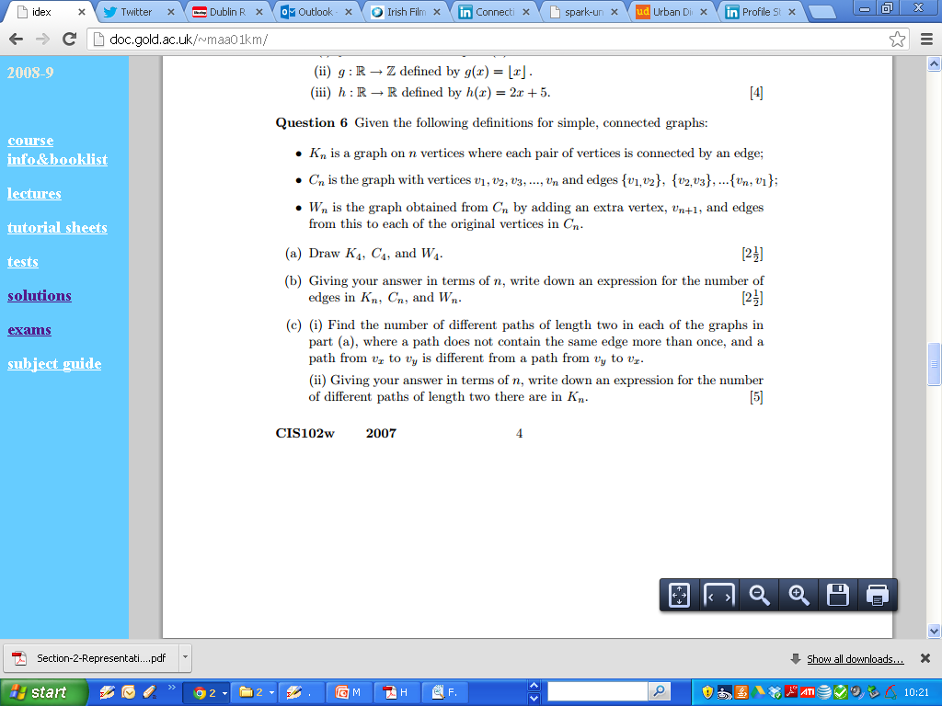
Graph Theory (2007)

Slide 7
Graph Theory (2007)

Slide 8
Graph Theory (2007- Part C not part of course)

Slide 9
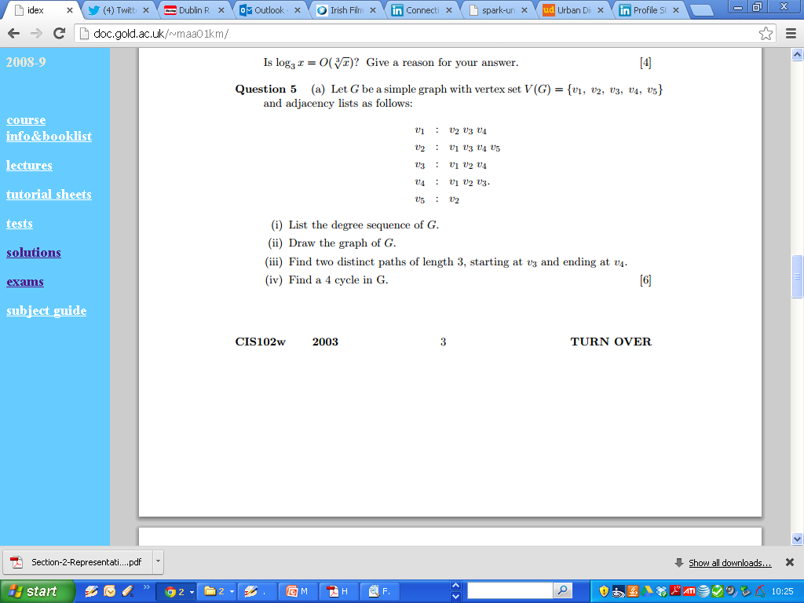
Graph Theory (2006)

Slide 10
Graph Theory (2006)

Slide 11
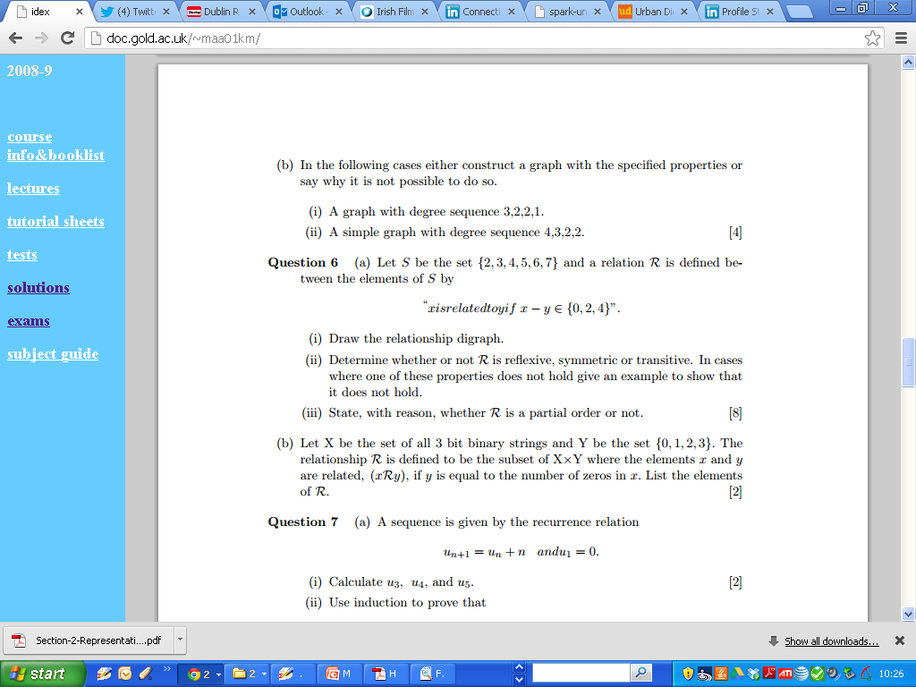
Graph Theory (2006)

Slide 12
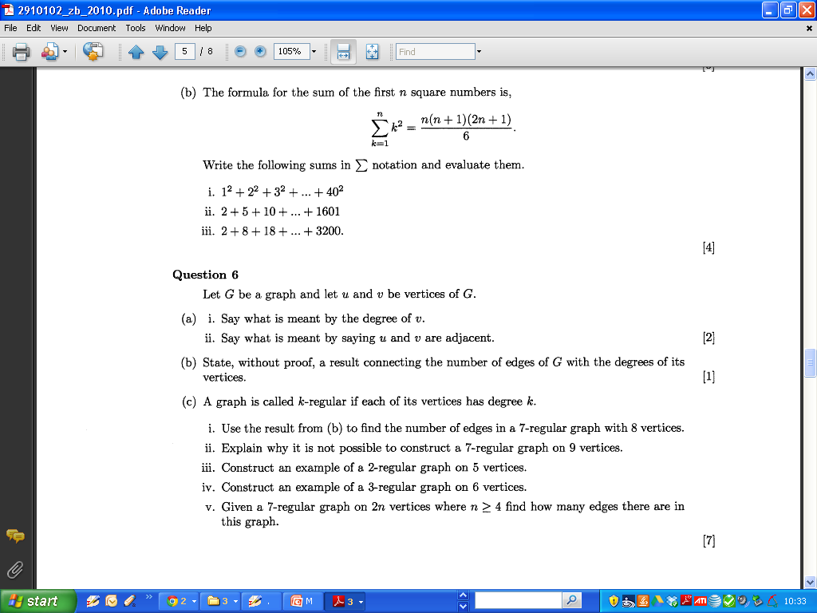
Graph Theory 2010

Slide 13
Graph Theory 2010

Slide 14
Graph Theory 2010

Slide 15
Graph Theory 2010

Slide 16
Graph Theory 2010

Slide 17
Graph Theory 2010

Slide 18
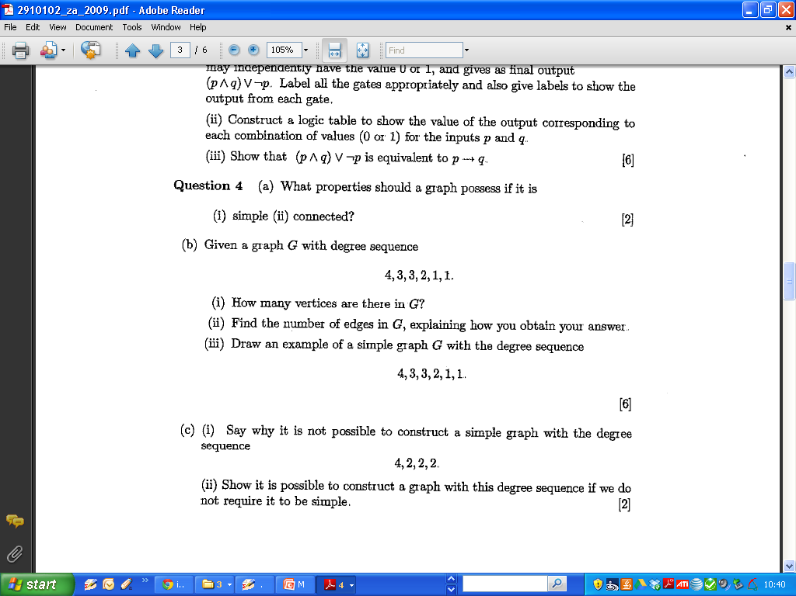
Graph Theory 2009

Slide 19
Graph Theory 2009

Slide 20
Graph Theory 2009

Slide 21
Graph Theory 2009

Slide 22
Blank Page

Slide 23
Blank Page

